Slide 1
IQ to B-mode Conversion & Endocardium Segmentation in Parasternal Short-axis Echocardiograms
Addison Elliott
04/18/2018

Slide 2
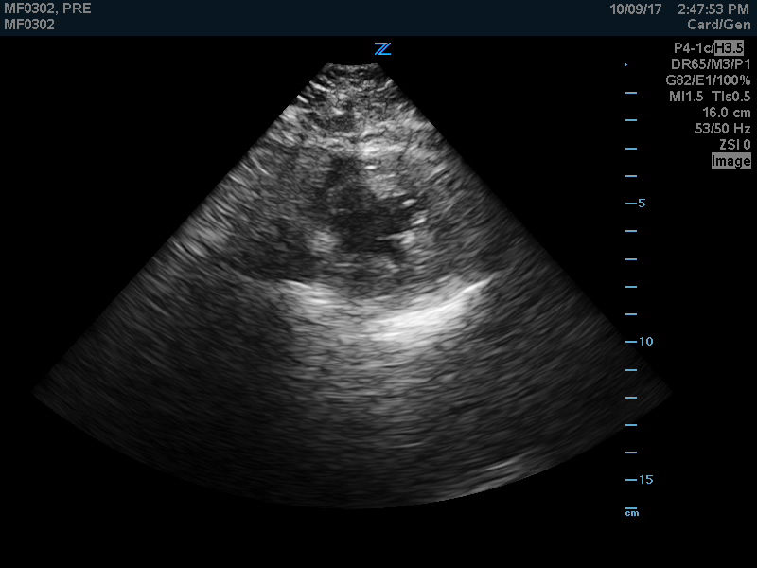
What are Echocardiograms?
Ultrasound imaging of the heart (image called B-mode)
Notes:
So you have a transducer that you place on the subject and it sends sound waves out in a fanning direction.
It’s taking images across time as well.
So a B-mode image is just one still image from the transducer and a B-mode loop is the entire time frame.
Show B-mode video.
This B-mode loop is taken near the apex or bottom of the heart.
Show where endocardium is.

Slide 3
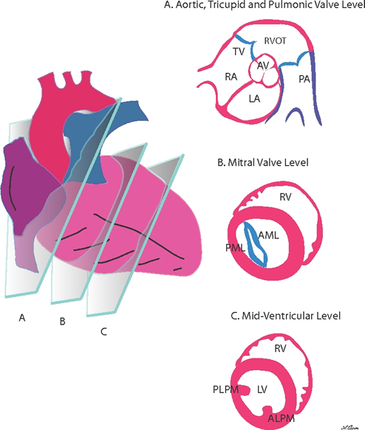
What are Parasternal Short-axis views (PSAX)?
Ignore Plane A
View near apex of heart, just a donut

Slide 4
Project Purpose
Part 1
Convert raw transducer data into B-mode images that you saw
Allows tuning of parameters (DR, TGC, gain, etc)
No public source code, have to start from scratch
Part 2
Use B-mode images at short-axis to segment short-axis views

Slide 5
Part 1: IQ to B-mode Conversion

Slide 6
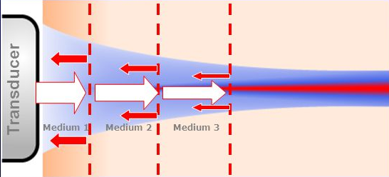
How Ultrasound Works
Transducer emits sound waves at frequencies of 1-10MHz (ultrasound)
Transducer measures amplitude and delay of reflected waves
Raw signal from transducer is radiofrequency (RF) data
In-phase and quadrature phase (IQ) data is similar

Slide 7
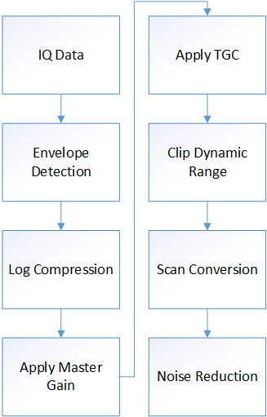
Block Diagram

Slide 8
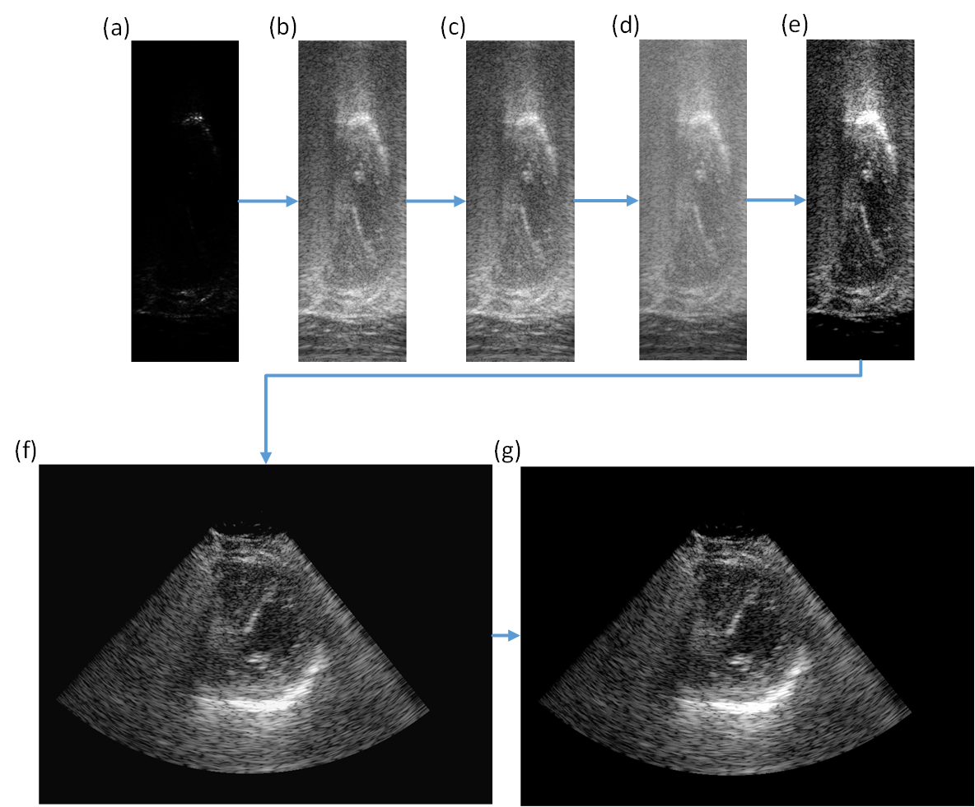
Review

Slide 9
Speckle Reduction
Very difficult problem to solve, many existing methods out there
In this study, following methods were examined:
Gaussian filter
Perona-Malik anisotropic diffusion
Median filter
Lee filter
Wavelet denoising

Slide 10
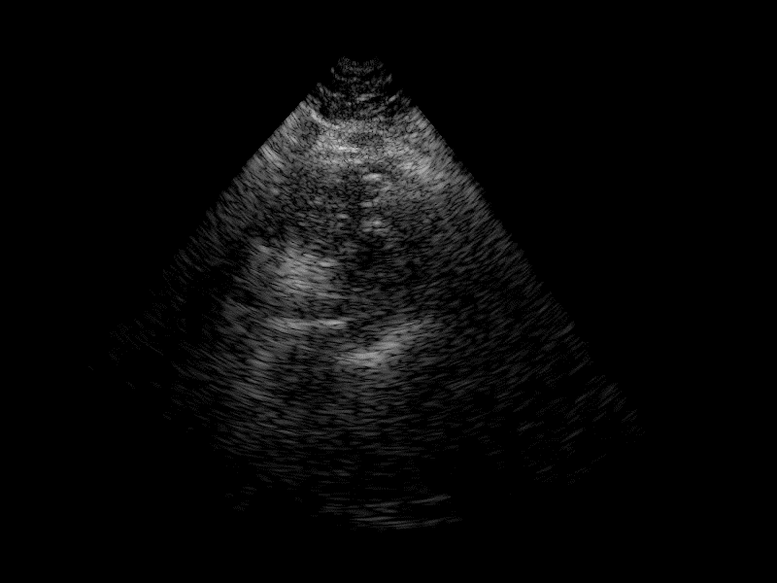
No Noise Reduction
Notes:
Smoothing filter applied to image

Slide 11

Gaussian Filter
Notes:
Smoothing filter applied to image

Slide 12

Anisotropic Diffusion
Notes:
Smoothing filter applied to image

Slide 13

Median Filter
Notes:
Smoothing filter applied to image

Slide 14

Lee Filter
Notes:
Smoothing filter applied to image

Slide 15

Wavelet’s Denoising
Notes:
Smoothing filter applied to image

Slide 16
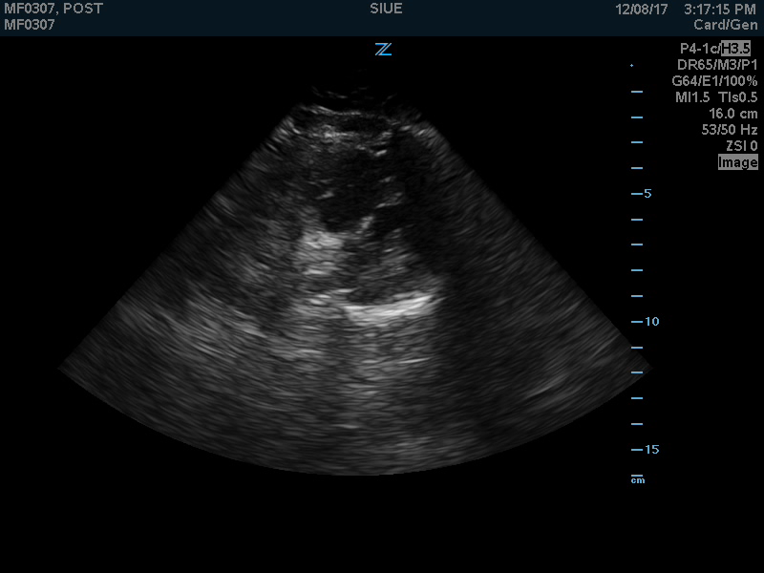
Ultrasound Machine
Notes:
Smoothing filter applied to image

Slide 17
Key Takeaways
Denoising is a second order problem
Small changes
Last 10% of work takes 90% of time
Gaussian & Anisotropic diffusion blur image
Not great for cardiologists, great for computer algorithms
Median, Lee & Wavelet
Visually about the same
Chose Wavelet because it seems slightly better than others

Slide 18
Part 2: Segmenting Endocardium

Slide 19
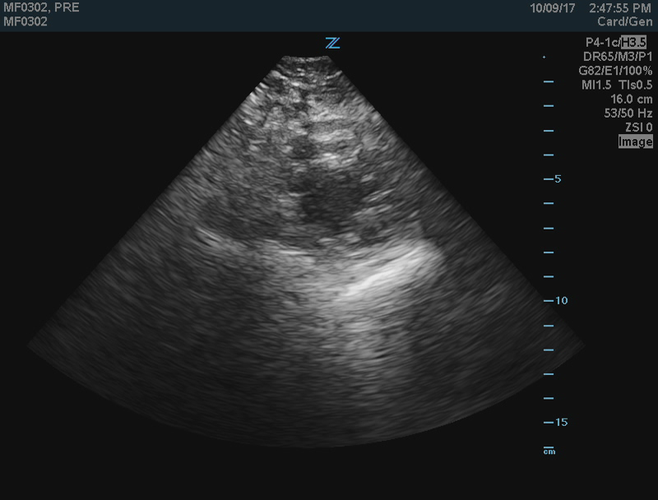
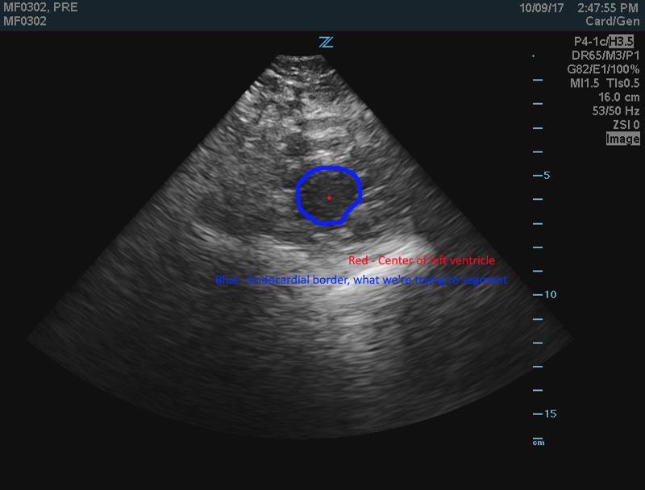
B-Mode PSAX near apex
Red- Center of left ventricle (LV)
Blue – Endocardial boundary

Slide 20
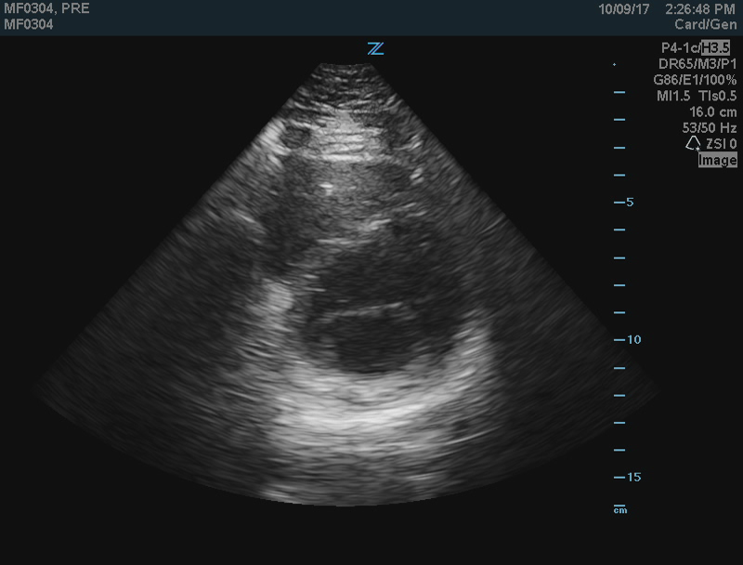
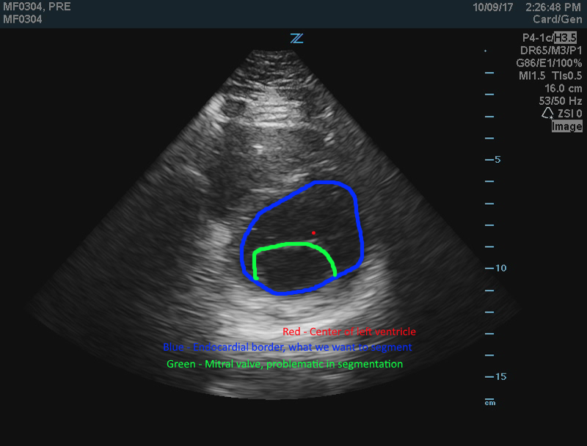
B-Mode PSAX at mitral valve
Red- Center of left ventricle (LV)
Blue – Endocardial boundary
Green – Mitral valve

Slide 21
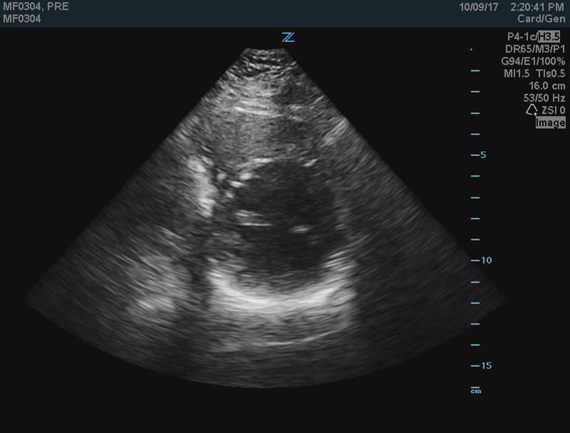
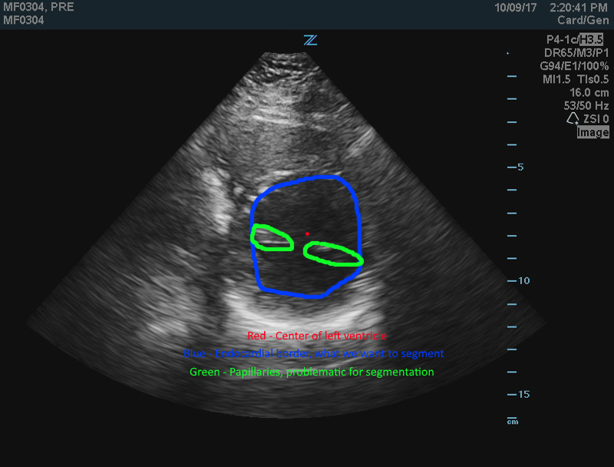
B-Mode PSAX at papillary muscles
Red- Center of left ventricle (LV)
Blue – Endocardial boundary
Green – Papillary muscles

Slide 22
Why do we care?
According to AHA, coronary heart disease is the #1 cause of death globally.
Measures to help diagnose and preemptively treat
Left Ventricle Ejection Fraction (LVEF)
Left Ventricle Mass/Volume
Ultrasound is primary method of cardiac health assessment
Cheap, portable, and non-invasive
MRI is bulky, time-consuming scans and expensive
Downside is ultrasound is very noise, called speckle noise
Tedious to do this manually, not typically done in practice.
Create segmentation algorithm to automatically calculate measures
Eventually quantify fat around heart

Slide 23
Segmentation Method
Smooth image to remove speckle noise (Anisotropic diffusion)
Transform to polar domain with center user-specified
Get edge image to use as cost
Sobel filter along radial direction
Equalize histogram
Perform dynamic programming using Dijkstra’s algorithm
Start point = user-specified start point
End point = one pixel to the left of start point
For each point, can only move East and adjacent pixels
Wrap around in the horizontal direction (angles are periodic)
Cost function = Edge image (inverted)

Slide 24
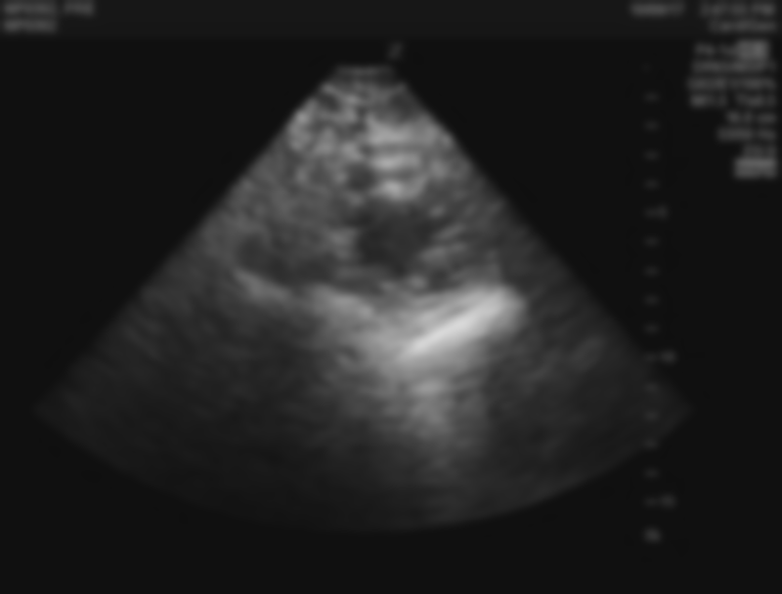
Smoothed Image

Slide 25

Polar Conversion
Notes:
Explain that X-axis is angular dimension, Y-axis is radial dimension. Origin is at lower-left

Slide 26
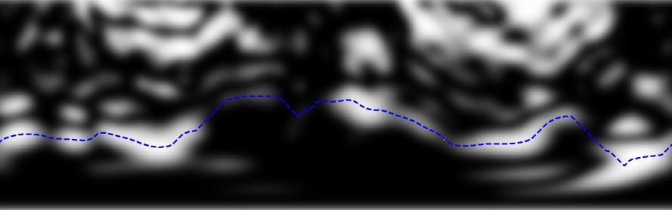
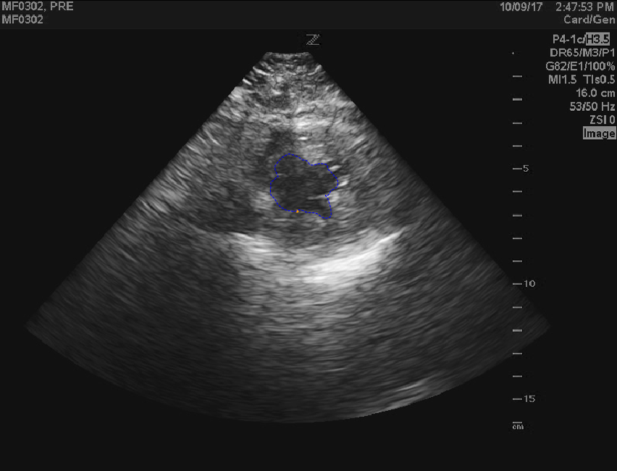
Endocardial Boundary (Apex)

Slide 27
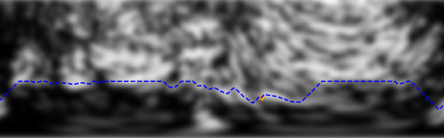
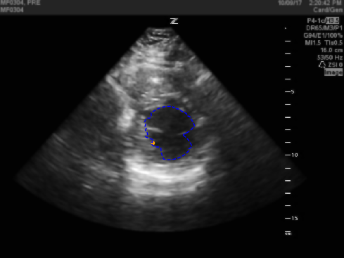
Endocardial Boundary (Mitral)
Notes:
Missing boundary, weak boundaries. Messing up

Slide 28
Additional Cost Functions
Missing or weak boundaries (like Mitral valve), does not work
Absolute Difference Method
Take radial difference from start point to current point, add to cost function
Constrains to circle with radius of start point
Derivative Method
Take derivative from current point to 5th optimal point back, add to cost function
Smooths out path, makes more circular

Slide 29
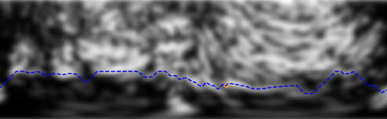
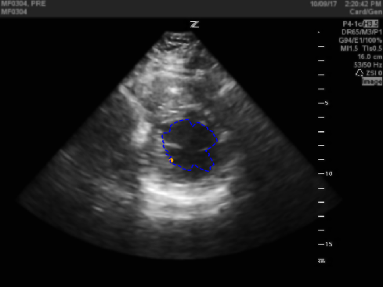
Mitral Valve w/ Abs Diff

Slide 30
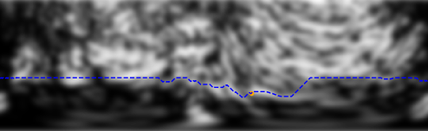
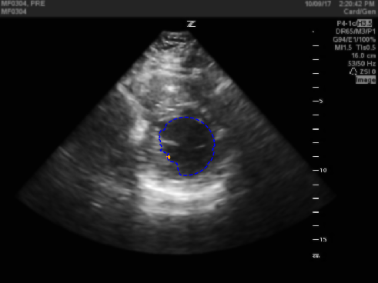
Mitral Valve w/ Derivative

Slide 31
Key Points
Did not get a chance to run on PSAX papillary muscle view
Messes up with missing or weak boundaries
Absolute Difference Cost Function
Did not work well with filling in missing boundaries
Derivative Cost Function
Did not work well with filling in missing boundaries
Worked nicely to smooth the contour however
Neither cost function could fill in missing boundaries

Slide 32
Future Work
Factor in temporal dimension
Use gradient for cost function
Use shape model or ASMs to segment boundaries
Consider Kalman filter to leverage multiple methods

Slide 33
Conclusion
Created algorithm to convert raw data to B-mode image
Created segmentation algorithm to segment endocardial boundary
Works well enough if boundaries are clearly defined, not always case for ultrasound
Build on both as future work, combine them to have one process.
Allows most parameters to tune

Slide 34
Questions?

Slide 35
Literature Review
Zhang et al. employed dynamic programming (DP) using Dijkstra’s algorithm on cardiac MRI image
Numerous shape-based models in echocardiograms
Good for interpolating missing boundaries
Requires existing shape model to be made
Active shape models are another common method
Start with initial contour and slowly move towards gradient of cost function
Factor in curvature and continuity

Slide 36
Project Purpose
B-mode image is missing a lot of information
E.g. spectral parameters of RF data can be analyzed in regions to differentiate tissues (Akhila’s project)
Need to have the B-mode image and RF data
Select region from B-mode
Get corresponding RF data from that region
Cannot collect both B-mode and RF data from machine.
This is why I am converting the IQ data to B-mode images
Also, allows tuning of parameters (DR, TGC, gain)

Slide 37
Related Works
Most ultrasound machines have proprietary software to convert from RF to B-mode image
Few papers on conversion from RF to B-mode image, but no speckle reduction
Few papers focusing on speckle reduction only
Importantly, no papers with publicly accessible source code. No code for us to use!

Slide 38
Software
Python 3.5.4 using Anaconda
Libraries:
NumPy
SciPy
Scikit-image
matplotlib
PyQt5
Jupyter for debugging

Slide 39
B-mode images
Raw data is converted into a brightness mode (B-mode) image
This is what most people see when dealing with ultrasound
Short-axis view of heart
Ultrasound is noisy (low SNR) Noise is termed ‘speckle’

Slide 40
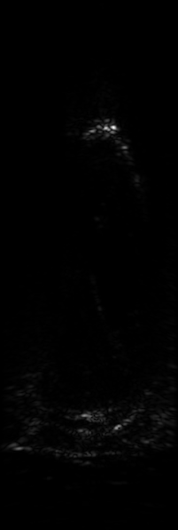
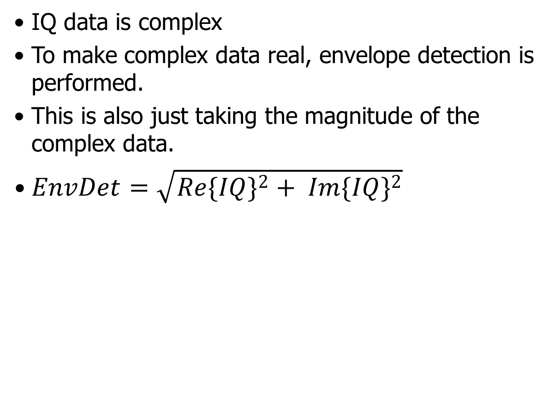
Envelope Detection
IQ data is complex
To make complex data real, envelope detection is performed.
This is also just taking the magnitude of the complex data.
$EnvDet=\sqrt{{Re\{IQ\}}^{2}+ {Im\{IQ\}}^{2}}$

Slide 41
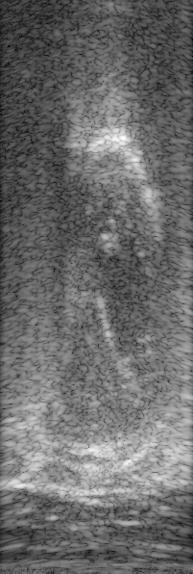
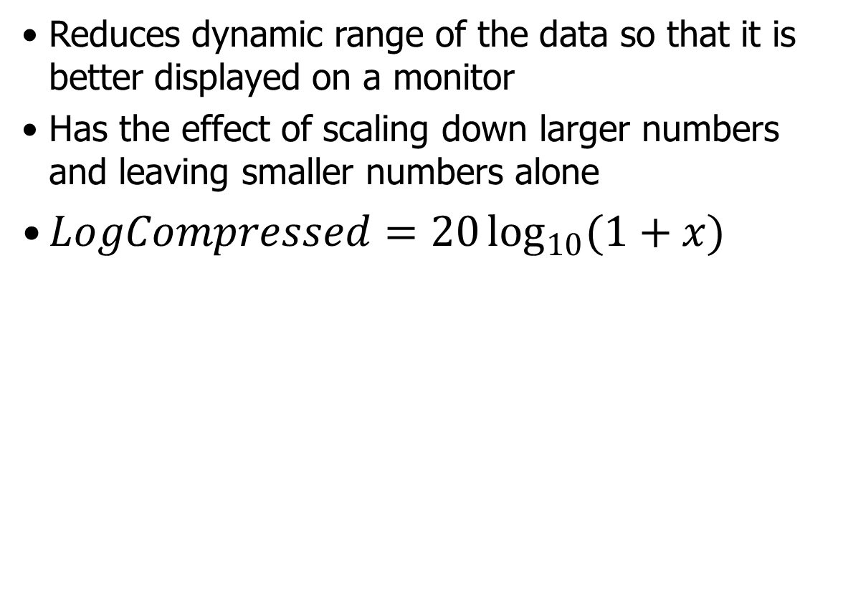
Log Compression
Reduces dynamic range of the data so that it is better displayed on a monitor
Has the effect of scaling down larger numbers and leaving smaller numbers alone
$LogCompressed=20\log_{10}{(1+x)}$

Slide 42
Apply Master Gain
Brightens entire image
Add constant value (in dB) to each pixel
Retrieve value ranging from -25 to 25dB from Ultrasound machine

Slide 43
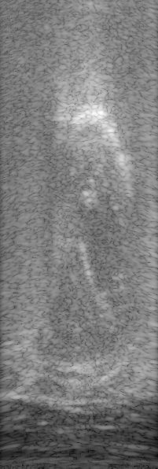
Apply Time Gain Compensation
Sound waves power decrease at square of radial distance
Results in darker regions farther away
Compensate by adding values based on distance away from transducer
Eight knobs with ranges from -20 to 20dB
Values are set at increments of Depth / 8 (2cm)
Linearly interpolate between each of the knobs for values for each depth

Slide 44
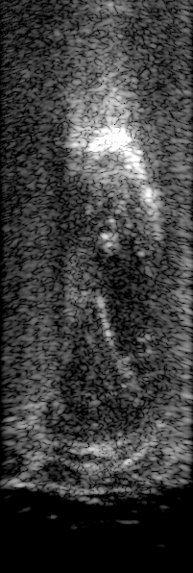
Clip Dynamic Range
Monitor maps values from 0-255 linearly
At this point, image has values from 0 – 70dB
Image looks bright because most content in 50-60dB and that’s ~85% of the maximum
Clip min/max values and normalize
Optimal dynamic range found to be 30-95dB

Slide 45
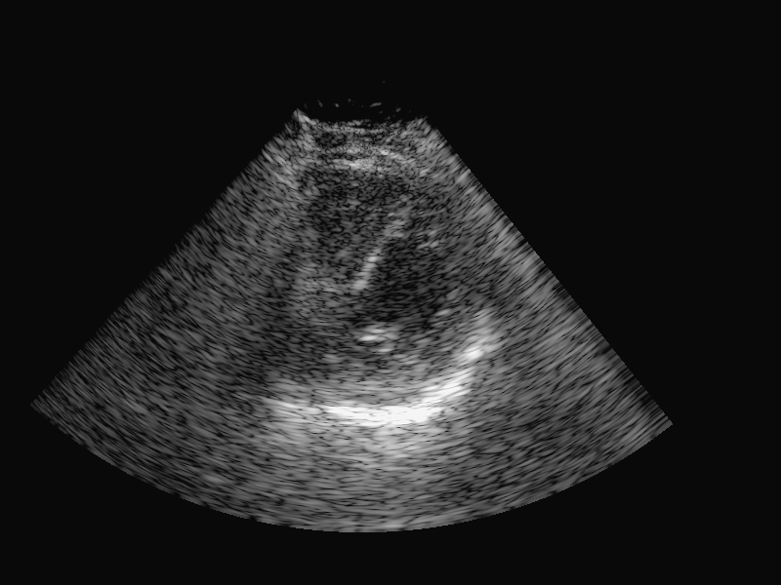
Scan Conversion
Phased array transducer creates fanning pattern
Convert from polar domain to Cartesian
Parameters:
Initial Radius: 30px
Final Radius: 508px
Initial Angle: 228º
Final Angle: 308º

Slide 46
Noise Parameters
Gaussian filter
Std. dev = 1.5
Perona-Malik anisotropic diffusion
# Iter = 5, Conduction Coeff = 30, Speed of Diff = 0.2
Median filter
Kernel size of 3
Lee filter
Kernel size of 3
Wavelet denoising
Two-level Daubechies-1
Hard-thresholding, variance = 0.5
Notes:
Smoothing filter applied to image

Slide 47
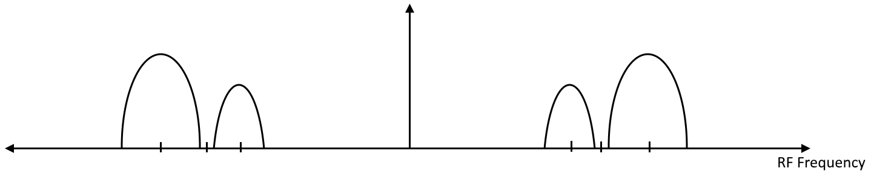
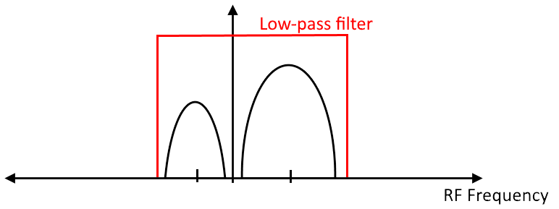
Converting RF to IQ data
We get IQ data from machine, conversion already done
1. Down-mixing (shifting signal to baseband)
2. Low-pass filter (remove negative copy of signal)
3. Decimate (reduces bandwidth for storing signal)

Slide 48
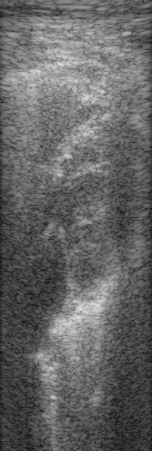
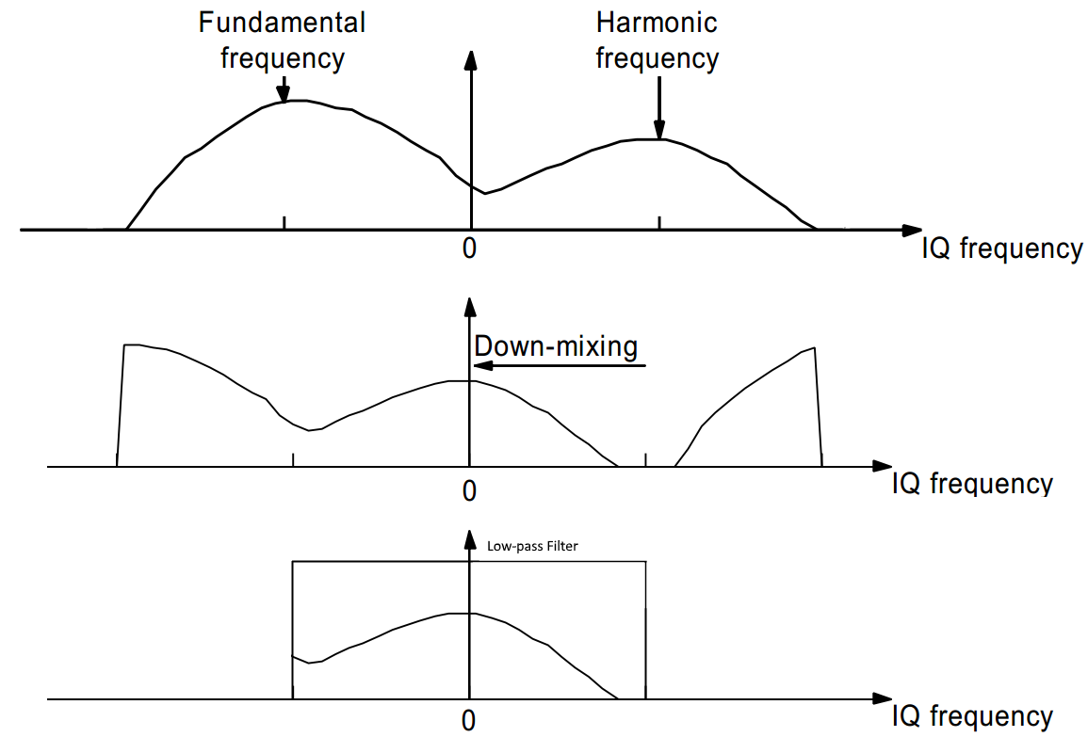
Filtering Second Harmonic
Not sure of sampling frequency, fundamental or harmonic frequency. Waiting to hear back from ultrasound rep.
IQ data contains fundamental and harmonic frequency
Down-mix the signal so that harmonic frequency is baseband
Low-pass filter to remove the fundamental frequency
This is the result without filtering harmonic frequency

Slide 49
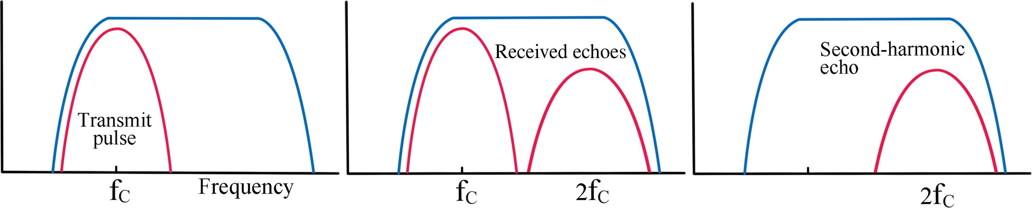
Tissue Harmonic Imaging (THI)
Improvement from traditional ultrasound
Transmit at one frequency (f_{c})
Receive at second harmonic (2 * f_{c})
Increases ultrasound image quality
higher frequency = quicker changes in image, thus better res.

